Slide 1

Setting up your goal
When to change
dev/test sets and
metrics
deeplearning.ai

Slide 2
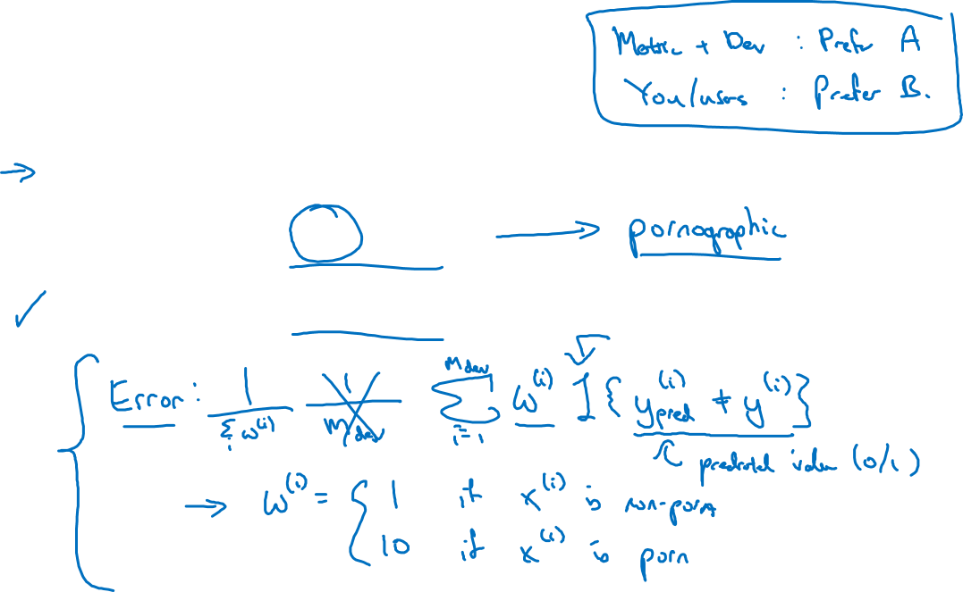
Cat dataset examples
Metric: classification error
Algorithm A: 3% error
Algorithm B: 5% error
Notes:
If you want this normalization constant,
technically this becomes sum over i of w(i),
so then this error would still be between zero and one
没懂这句

Slide 3
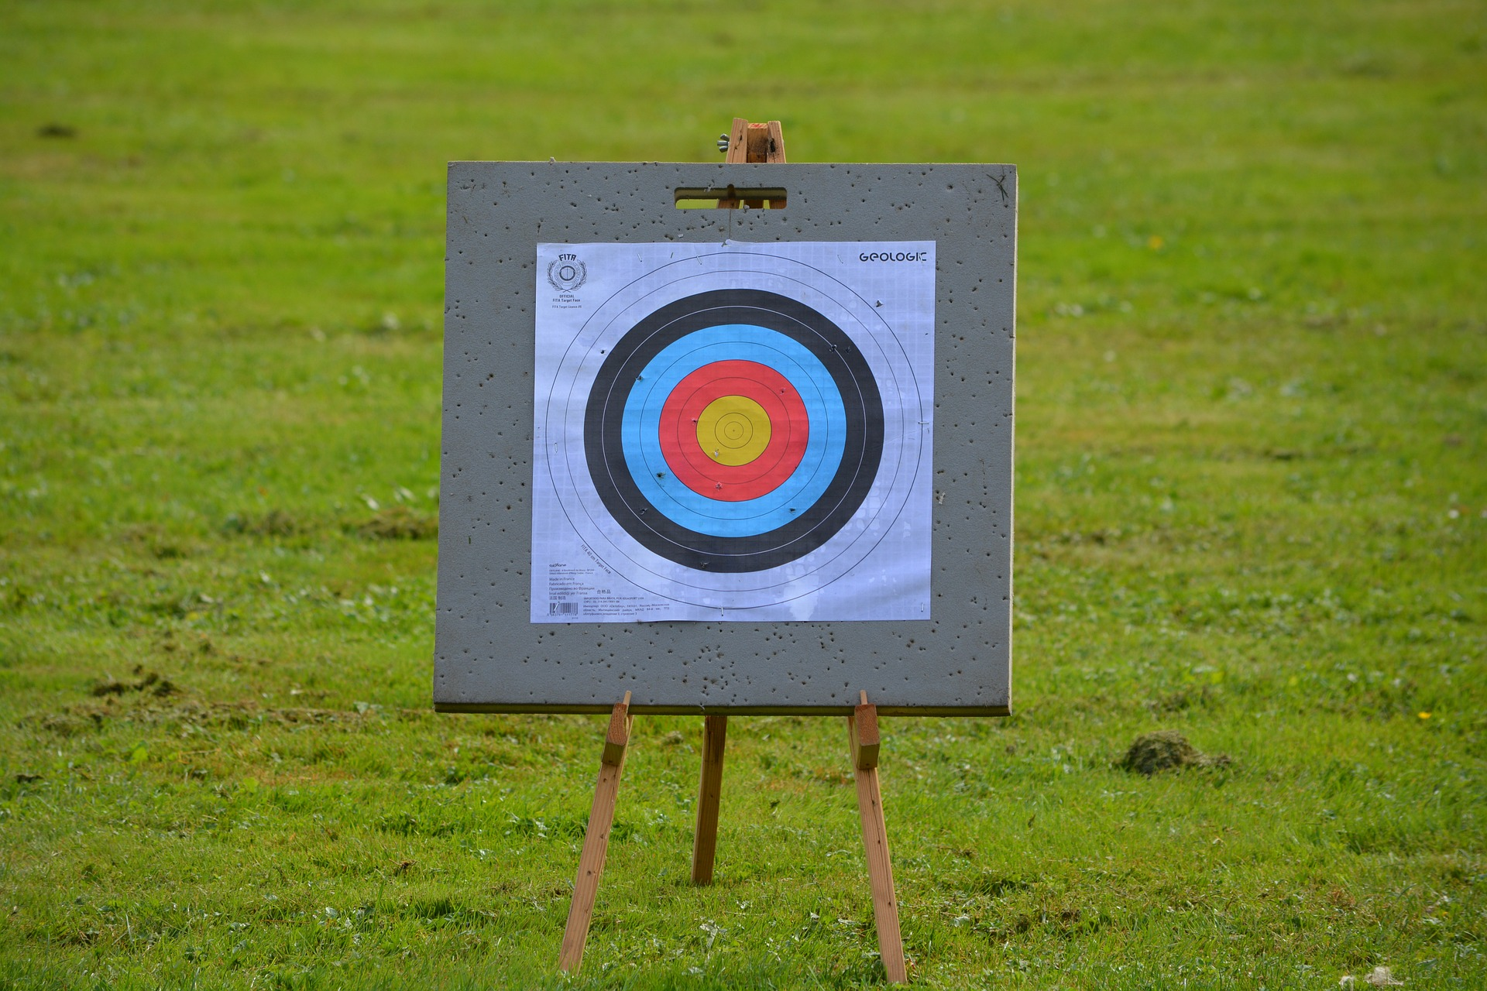
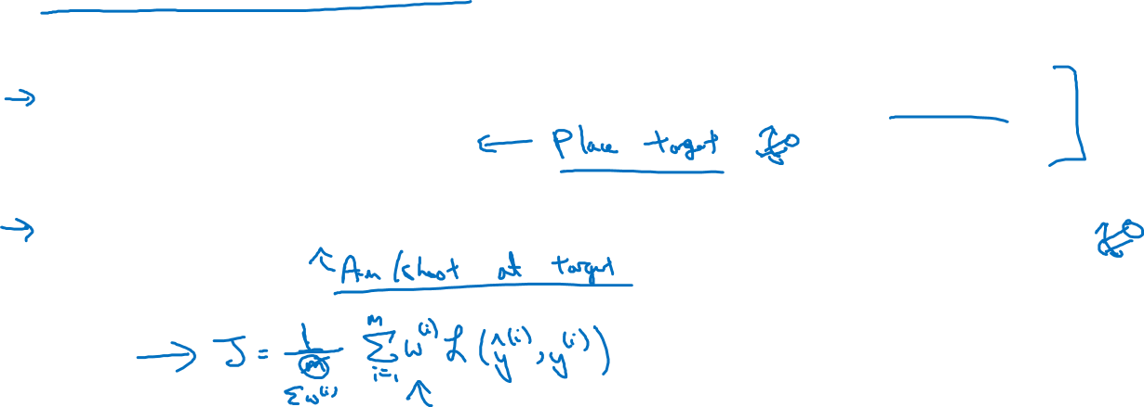
Orthogonalization for cat pictures: anti-porn
So far we’ve only discussed how to define a metric to evaluate classifiers.
2. Worry separately about how to do well on this metric.

Slide 4

Another example
Algorithm A: 3% error
Algorithm B: 5% error
Dev/test
User images
If doing well on your metric + dev/test set does not
correspond to doing well on your application, change your
metric and/or dev/test set.
Notes:
就是在dev set表现好的
不见得real world就是好的
So my recommendation is,
even if you can't define the perfect evaluation metric and dev set,
just set something up quickly and use that to drive the speed of your team iterating.
And if later down the line you find out that it wasn't a good one,
you have better idea, change it at that time, it's perfectly okay.
But what I recommend against for the most teams is
to run for too long without any evaluation metric and
dev set up because that can slow down
the efficiency of what your team can iterate and improve your algorithm.

